Slide 1
MACHINE LEARNING FUNDAMENTALS
Decision Trees
vs. K-Nearest Neighbors
A comparative analysis of rule-based logic versus proximity-based prediction.
Classification
Regression
Supervised Learning

Slide 2
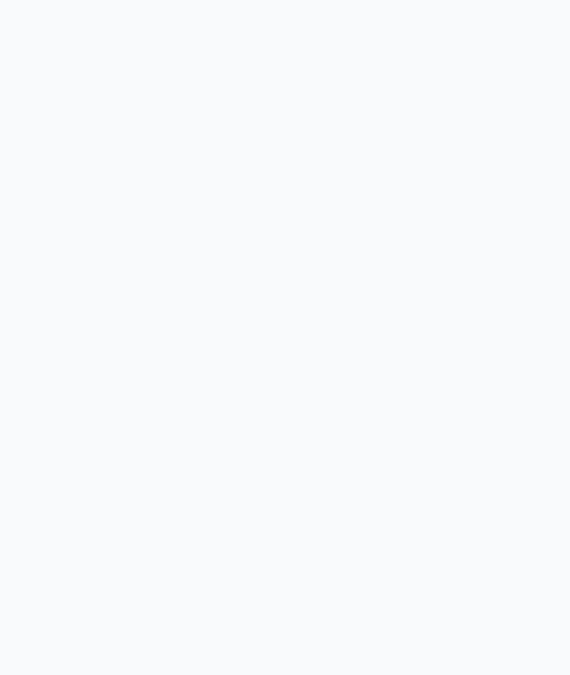
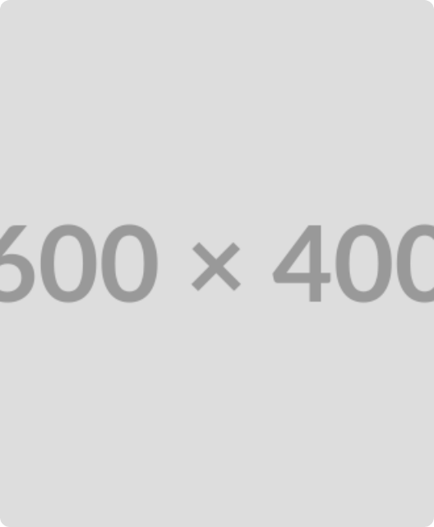
ALGORITHM 01: DECISION TREE
Rule-Based Partitioning
Hierarchical Structure: Splits data sequentially from root to leaf nodes.
Feature Selection: Chooses optimal splits to maximize data homogeneity.
High Interpretability: Mirrors human decision-making processes visually.
02
Decision Tree Overview

Slide 3
THE MATH BEHIND THE BRANCHES
Splitting Criteria
Entropy
Information Gain
Gini Index
Measures data randomness. Lower entropy means purer nodes.
Quantifies entropy reduction after a split.
Probability of misclassifying a random instance.
03
Decision Tree Math

Slide 4
ALGORITHM 02: K-NEAREST NEIGHBORS
Proximity Prediction
Instance-Based: Memorizes training data instead of building a model.
Distance Metrics: Relies heavily on Euclidean or Manhattan calculations.
Lazy Learner: Zero training time, but computationally heavy at prediction.
04
KNN Overview

Slide 5
The Crucial Hyperparameter
"K"
The number of nearest neighbors considered for majority voting. Too small causes overfitting; too large causes underfitting.
05
KNN Mechanics

Slide 6
Head-to-Head Comparison
06
Comparative Analysis

Slide 7
COMPUTATIONAL EFFICIENCY
Time Complexity Trade-offs
Decision Tree
KNN
Training: Slow. Must calculate splits across all features.
Training: Zero. Just stores the dataset (Lazy Learner).
Prediction: Very slow. Scans entire dataset for distance calculations.
Prediction: Extremely fast. Simple if-else traversal.
Memory: Very low. Only stores tree nodes and logic.
Memory: Very high. Must hold entire dataset in RAM.
07
Time & Memory

Slide 8
Data Handling & Sensitivity
Factor | Decision Tree | KNN
Feature Scaling | Not required. Unaffected by scale. | Crucial. Requires normalization.
Interpretability | High (White-box model). | Low (Black-box prediction).
High Dimensionality | Handles well through selection. | Poor. Suffers from curse of dimensionality.
08
Data Sensitivity

Slide 9




Selection Framework
Use Decision Trees When:
Interpretability is mandatory for stakeholders, the dataset is large, or when avoiding extensive data preprocessing (like scaling) is preferred.
Use KNN When:
The dataset is small to medium, prediction speed is not critical, and data lacks a defined mathematical distribution (non-parametric approach).
09
Selection Criteria

Slide 10

Algorithm selection is context dependent.
There is no universal best algorithm. Balance dataset size, available memory, and interpretability requirements.
10
Conclusion

